Slide 1
Achieving with Rx
Sean McCarthy
scmccart@gmail.com
@mccartsc
Seanmccarthy.me

Slide 2
What we’re up to…
Talk about what we’re up to.
Build a small task management app
Make it publish events about the tasks (add, update, delete)
Harvest those events and use Rx to look for achievement worthy activity
Notify the user of their achievement via a toast notification

Slide 3
What we’re using…
Asp.Net MVC/WebApi + Entity Framework + Backbone
RabbitMQ + EasyNetQ
Reactive Extensions for .Net (Rx)
Signalr + toastr

Slide 4
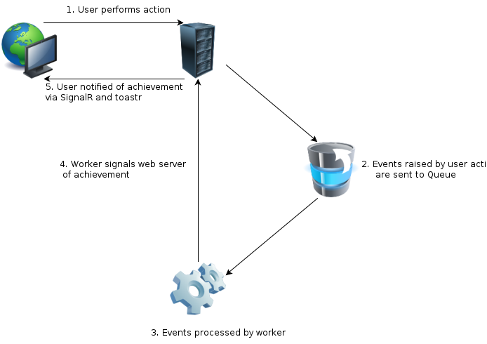
What it will look like…

Slide 5
IEnumerable vs. IObservable Push vs. Pull
 | Single | Many
Pull | T | IEnumerable<T>
Push | Task<T> | IObservable<T>

